Slide 1
Comparator Instructions
© 2015 John Sefcovic

Slide 2
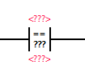
Comparator
Equal To
The EQUAL input instruction compares two values Operand 1 to Operand 2. If the values are equal, it allows rung continuity. Operand 1 and Operand 2 can either tags that contain values or be constant values, however Operand 1 and Operand 2 cannot both be constants.

Slide 3
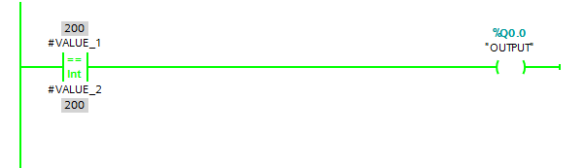
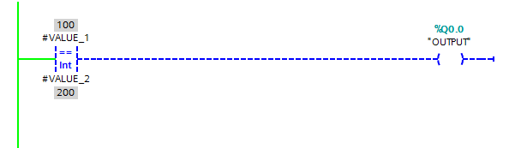
Comparator
Equal To

Slide 4
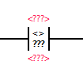
Comparator
Not Equal
The NOT EQUAL input instruction compares two values to not be equal. If Operand 1 and Operand 2 are not equal, the instruction is logically true. If the two values are equal, the instruction is logically false. Operand 1 and Operand 2 can either be tags that contain values or be constant values, however Operand 1 and Operand 2 cannot both be constants.

Slide 5
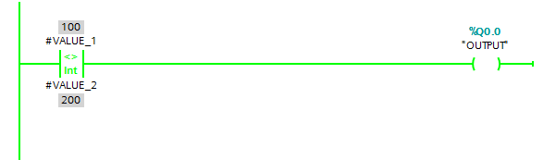

Comparator
Not Equal

Slide 6
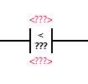
Comparator
Less Than
The LESS THAN input instruction compares if Operand 1 is less than Operand 2 for the instruction to be logically true. Operand 1 and Operand 2 can be either tags that contain values or be constant values, however Operand 1 and Operand 2 cannot both be constants.

Slide 7


Comparator
Less Than

Slide 8
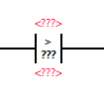
Comparator
Greater Than
The GREATER THAN input instruction compares if Operand 1 is greater than Operand 2 for the instruction to be logically true. Operand 1 and Operand 2 can either be tags that contain values or be constant values, however Operand 1 and Operand 2 cannot both be constants.

Slide 9
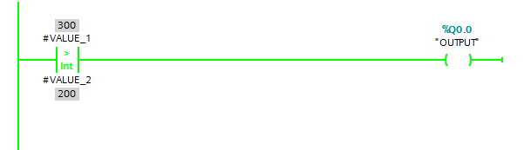

Comparator
Greater Than

Slide 10
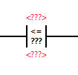
Comparator
Less Than Or Equal
The LESS THAN or EQUAL input instruction compares if Operand 1 is less than or equal to Operand 2 for the instruction to be logically true. Operand 1 and Operand 2 can be either tags that contain values or be constant values, however Operand 1 and Operand 2 cannot both be constants.

Slide 11
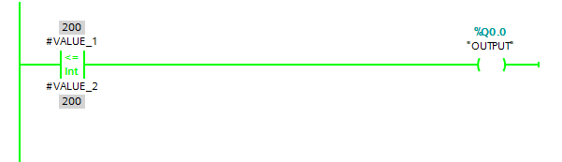


Comparator
Less Than Or Equal

Slide 12
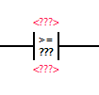
Comparator
Greater Than Or Equal
The GREATER THAN or EQUAL input instruction compares if Operand 1 is greater than or equal to Operand 2 for the instruction to be logically true. Operand 1 and Operand 2 can either be tags that contain values or be constant values, however Operand 1 and Operand 2 cannot both be constants.

Slide 13



Comparator
Greater Than Or Equal

Slide 14
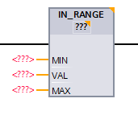
Comparator
In Range
The IN RANGE conditional input instruction tests for values to be within a specified range. The Value is compared to the Minimum and Maximum to determine if the instruction is logically true. The Minimum or Maximum can either be tags that contain values or be constant values, however the Value cannot be a constant, it must be a tag.

Slide 15
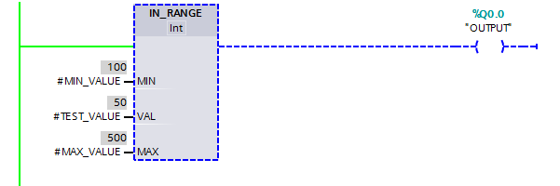
Comparator
In Range
The Value is less than the Minimum…
Minimum
Maximum
n
number line
n + 1

Slide 16
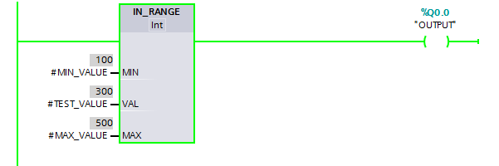
Comparator
In Range
The Value is within the Minimum and Maximum…
Minimum
Maximum
n
number line
n + 1

Slide 17
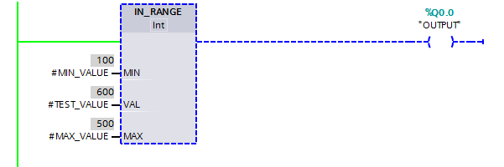
Comparator
In Range
The Value is greater than the Maximum…
Minimum
Maximum
n
number line
n + 1

Slide 18
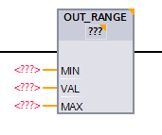
Comparator
Out Range
The OUT RANGE conditional input instruction tests for values to be outside a specified range. The Value is compared to the Minimum and Maximum to determine if the instruction is logically true. The Minimum or Maximum can either be tags that contain values or be constant values, however the Value cannot be a constant, it must be a tag.

Slide 19
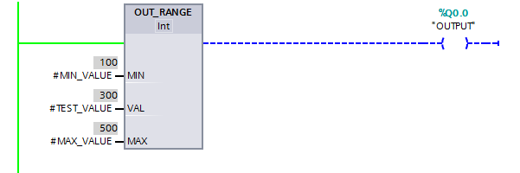
Comparator
Out Range
The Value is within the Minimum and Maximum…
… the High Limit value.
Minimum
Maximum
n
number line
n + 1

Slide 20
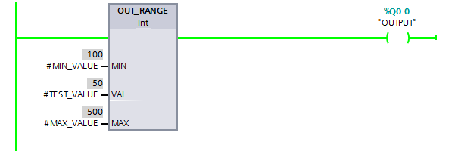
Comparator
Out Range
The Value is less than the Minimum…
… the High Limit value.
Minimum
Maximum
n
number line
n + 1

Slide 21
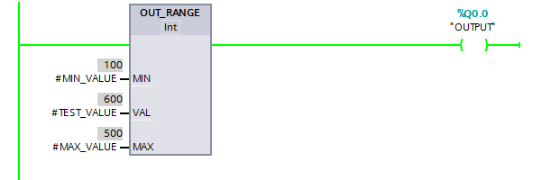
Comparator
Out Range
The Value is greater than the Maximum…
… the High Limit value.
Minimum
Maximum
n
number line
n + 1

Slide 22


Comparator
When the instruction is first entered, there are three sets of question marks.
Two of the question marks are for the tags.
The values may be entered in Tag Editors, Data Block or Instance.

Slide 23

Comparator
When the first Tag is entered, the set of question marks in the instruction assumes the Data Type for the instruction.
When the first Tag is entered,

Slide 24
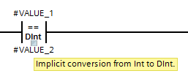
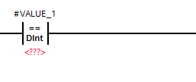
Comparator
The square indicates a conversion.
Compare
VALUE_1 is a Dint, (Double Integer)
VALUE_2 is a Int, (Integer)
When the second tag is entered, and is different from the instruction’s Data Type, the tag’s Data Type is converted to the instruction’s Data Type.
This is only for the interpretation of the instruction, the Tag’s actual Data Type remains unchanged.
Note: Not all Data Types can be converted. The conversion is dependent on the Data Type pairs.

Slide 25
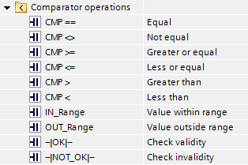
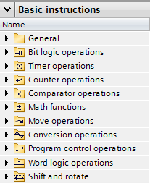
Comparator
The Comparator instructions are Basic Instruction in the Comparator operations folder.

